Slide 1
Advanced Algorithmics 1
PBL Presentation

Slide 2
Plan
Program
Problem-based learning
Organization
Evaluation

Slide 3
Semester program
Data structures and their implementations:
Stacks
Files
Sorting algorithms
Complexity concept
Hash tables

Slide 4
Problem-based learning
A specific problem is proposed
the active resolution of this problem naturally leads students to acquire the various concepts of the course and to understand how to implement them.

Slide 5
Problem-based learning: ingredients
Explicit learning objectives.
A problem situation presented in a statement.
Systematized treatment of the problem situation in 2 phases: Outbourd session and Return session
Resources for learners and tutors
Learners organized into groups
Logistics (premises, tables, flipcharts, desks, computers, video projectors, etc.)

Slide 6
Problem-based learning: team
Groups of 3, 4 or 5 students
Each student has a clearly defined role
Groups are formed by the teachers

Slide 7
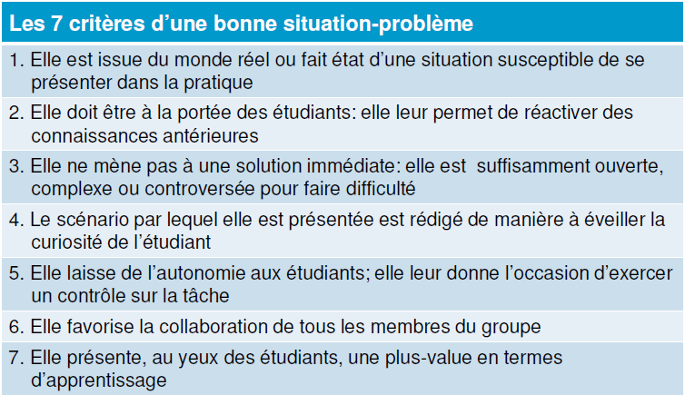

Slide 8
Problem-based learning
Problem-based learning takes place in four stages:
ClassTD
Outbound seance
Return seance

Slide 9
Problem-based learning:
Outbound seance:
Allocation of functions to be assumed within the group
Handover of the booklet containing the problem
Analysis and division of the problem into tasks
Assignment of tasks to solve the problem
Each group has a board on which students can write and structure their ideas.

Slide 10
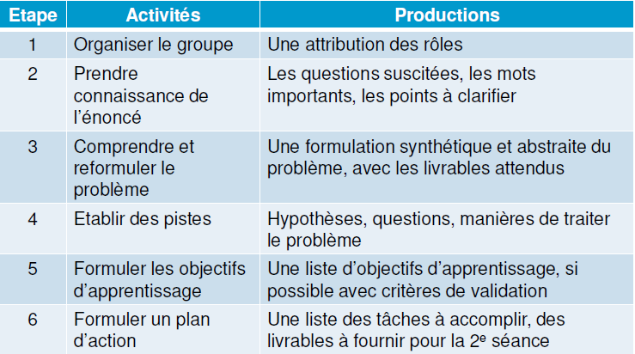

Slide 11
Problem-based learning:
Individual work
Each learner carries out the individual work determined by the group work during the “Outbound" session:
Study of resources
Self-evaluation of learning
Formulation of outstanding questions
Production of deliverables

Slide 12
Problem-based learning:
Third stage: Return seance
Summary of work carried out by each person
Production of deliverables
Validation of targeted learning outcomes

Slide 13
Problem-based learning:
Certificate evaluation
It comes after the "return" session
It is individual and collective
It allows you to validate what you've learned and score points (motivation!)

Slide 14
Problem-based learning: Johnson, D.; Johnson, R. & Holubec, E. (1998) Cooperation in the classroom. Boston : Allyn and Bacon
A more positive relationship with matter
More positive relations between students
Better psychological health

Slide 15
Organization
This module contains 24 hours.
The 16 seances are divided as follows:
APP (4 times 6h):
Course (1h30)
TD (1h30)
Outbound seance (1h30)
Return seance (1h30)

Slide 16
Evaluation
The assessment comprises 4 marks:
1 APP tutor mark (20%)
1 quiz mark (15%)
1 midterm exam (25%)
1 partial exam (40%)

Slide 17
Some truths about P.B.L:
The P.B.L: is not just a group work:
The P.B.L alternates between group work time and individual work time, but it is a method which gives a prominent place to individual learning (the time you will have to devote to learning and individual work is four to six hours per student).
The P.B.L does not give students total freedom:
The PBL gives freedom, but within a structured framework. The PBL aims to structure collective and individual work: it's an explicit method!
In A.P.P. the group does not mask the individual:
Individual learning is the goal: the group serves to reveal the individual learning of its members. The group is used to compare points of view.
The confrontation of different points of view provokes reactions that lead to the reformulation of one's own point of view ("cognitive confusion").

